Slide 1
Digital Learning
Prepared By:
Priyanshi Shah(110300107019)
Varun Shah (110300107020)

Slide 2

Definition
Digital Learning is any instructional practice that uses technology to strengthen a student's learning experience.
It emphasizes high-quality instruction and provides access to challenging content, feedback through formative assessment, opportunities for learning.

Slide 3
Scope
Providing a Tablet to every student is a strategy, that employs to prepare students for success in today's world.
In our 1 to 1 learning environment, students would be provided with an tablet to better equip them for learning, teachers would receive continuous professional development to better equip them to provide innovative instruction, and all would be a part of a high quality education.

Slide 4
Abstract
The purpose of Project, is to provide Effective communication between mobile devices.
As connection between master and clients is established, data can be shared by Master. Master will be able to broadcast messages or content connected to clients(nodes).Client will be able to identify master and will be able to connect as and when master is available.
One click installer, which will act as a master or node based on configuration. Configurations are required to set after installation.
As the number of Internet access points are growing rapidly, Digital-Learning is also gaining a new peak. It provides the best medium between students and teacher, with the help of rich multimedia.

Slide 5
Objective
-To improve student's learning through technology.
Students can easily connect to the best teachers, by their Tablets.
The application also provides, to choose the appropriate subject.
-To serve the students, in best manner.
Digital Learning also provides the facility to also take exams. Results can be easily evaluated by the teachers. And Reports will be generated on the basis of students' performances.
-To update Parents, about their Children's performance
The grades, regular performance of the students can be easily checked by the parents.
The performance of the student will also be updated to the parents by sending them mails.

Slide 6

What's new
By using, Digital Learning as a Learning Tool, Students will be able to gain a great knowledge of Technologies.
In the application,rich Graphics will be used, which will also attract the students in a large number.
Teachers will get rid from tedious paper work, of storing students’ information.

Slide 7
Working Principle
Digital working, learning and information sharing is the strategy. This strategy sets out principles, which are:
Digital learning is recognized as a crucial part of workforce development, and part of blended approach to learning and development including the achievement of standards and qualification.
Digital technologies are used in the best interests of people , to support their choice and independence.
Digital Information is shared securely and transparently, so people have confidence in the system used to store information electronically.

Slide 8
Users
Teacher
Students

Slide 9
Modules
Teacher
Create Connection
Analysis
Generate Reports
Send Reports
Broadcast Academic work

Slide 10
B) Student
Choose Mode
Connect to Master Device
Disconnect to Master Device
Select Subject
Select Chapter

Slide 11
Hardware (Preferable Configuration)
Booted and wi-fi configured Tablet
1 Gb RAM Recommended
8 GB Internal Memory

Slide 12
Software (Preferable Configuration)
Programming Environment:
Intellij Idea, Community Edition, which is the most intelligent JAVA IDE.
WebServer : xampp(mac), wampserver(windows)
Platform: Android

Slide 13
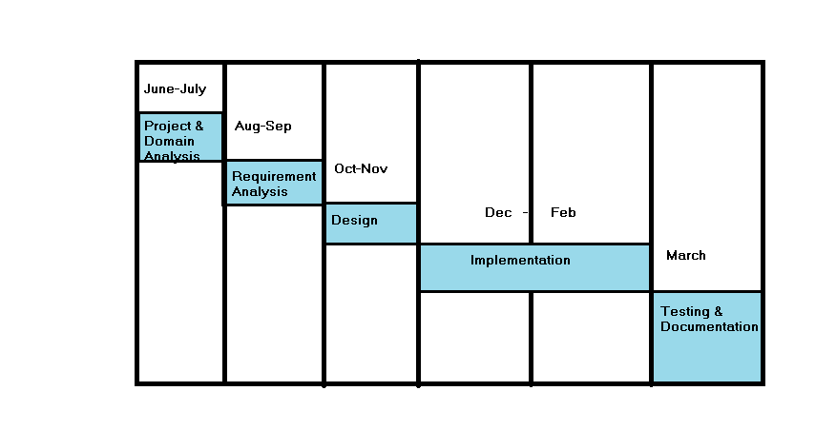
Schedule

Slide 14
Advantages
Of
Software
All the students will be given a tablet.
Digital Learning as a Learning Tool, Students will be able
to gain a great knowledge of Technologies.
In the application , rich Graphics will be used, which will also attract the students in a large number.
Teachers will get rid from tedious paper work, of storing students’ information.
Better estimation of effort.

Slide 15
Conclusion
The project DIGITAL LEARNING is made after checking project’s workability in all aspects and in accordance to the users’ requirements with a moderate degree of security mechanisms as well as provision for future enhancements, as they would come with time.
The Digital Learning is an education Application system that improves vastly over the old system, which was inefficient. The project DIGITAL LEARNING is made keeping in mind the present requirements, the lessons learnt from the past system and possible future needs of the users.
These Application would generate curiosity in Students to learn their academics in enhanced way.

Slide 16
Generated Report with respect to Students’ work would help them to analyze their performace and will be easy to determine how to increase performance in respective area.
To make DIGITAL LEARNING more flexible for all users, emphasis was on proper management of resources (Device as well as humans) during the analysis as well as the designing too.
Thus the system is capable of handling a wide range of enhancements.
DIGITAL LEARNING hopes to serve the purpose for which it was created well and adapt to the changing requirements in an effective way.

Slide 17

References
Books:
Author Sams, "Teach Yourself Androi Application Development in 24 hours”.
Authored by Ed Burnette, “Hello, Android”.

Slide 18
Websites/ Videos:
"To learn Basic Android" http://www.tutorialspoint.com/android/index.htm
" To learn different views and material designs " http://developer.android.com/index.html
Reffered to Videos of "TheNewBoston" , for learning how to make basic applications.
www.stackoverflow.com

Slide 19
UseCase for Launcher Screen

Slide 20
UseCase for Student Mode

Slide 21
Sequence Diagram for Teacher Mode

Slide 22
Sequence Diagram for Student Mode

Slide 23
Sequence Diagram for parents

Slide 24
Class Diagram

Slide 25
Activity Diagram for Generating And Sending Report to The Parents

Slide 26
State Diagram for Launcher Screen

Slide 27
State Diagram For Teacher Mode

Slide 28
State Diagram for Establishing Connection

Slide 29
State Diagram For Learning Procedure

Slide 30
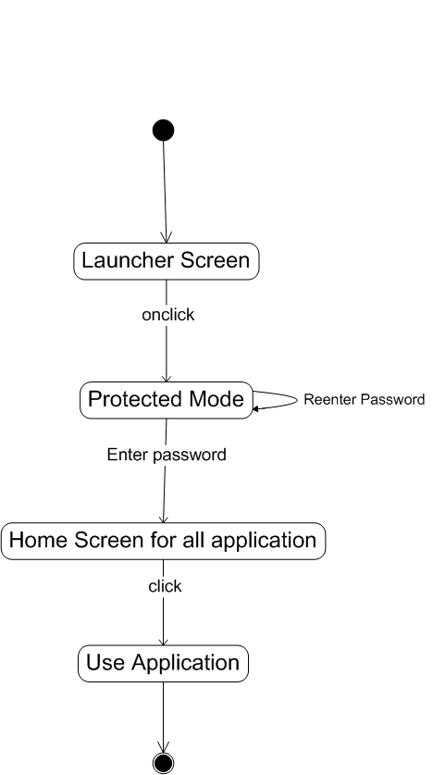
State Diagram for Using Protected Mode

Slide 31
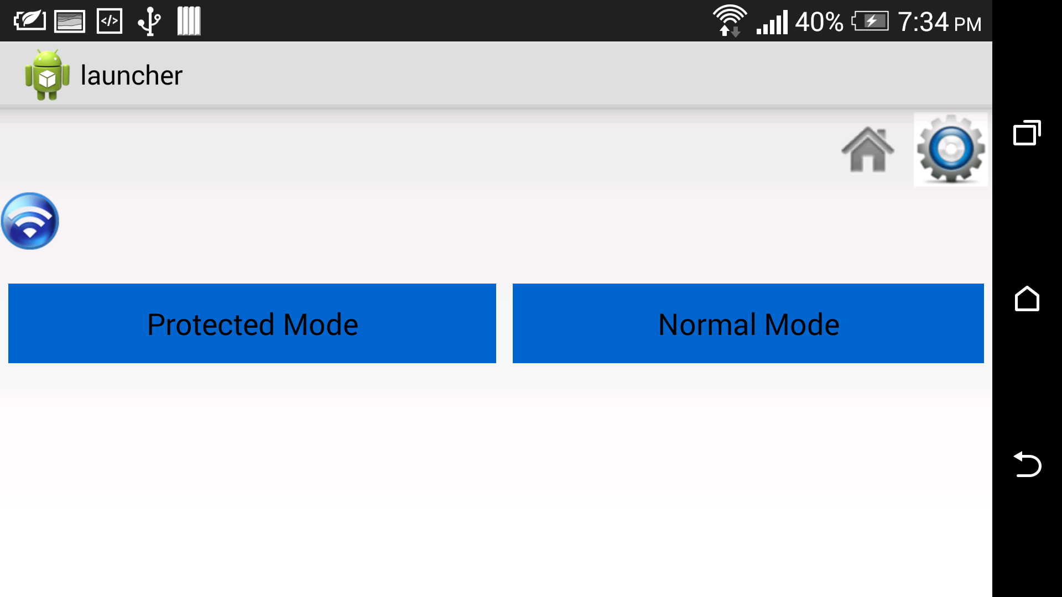
Student Side GUI

Slide 32
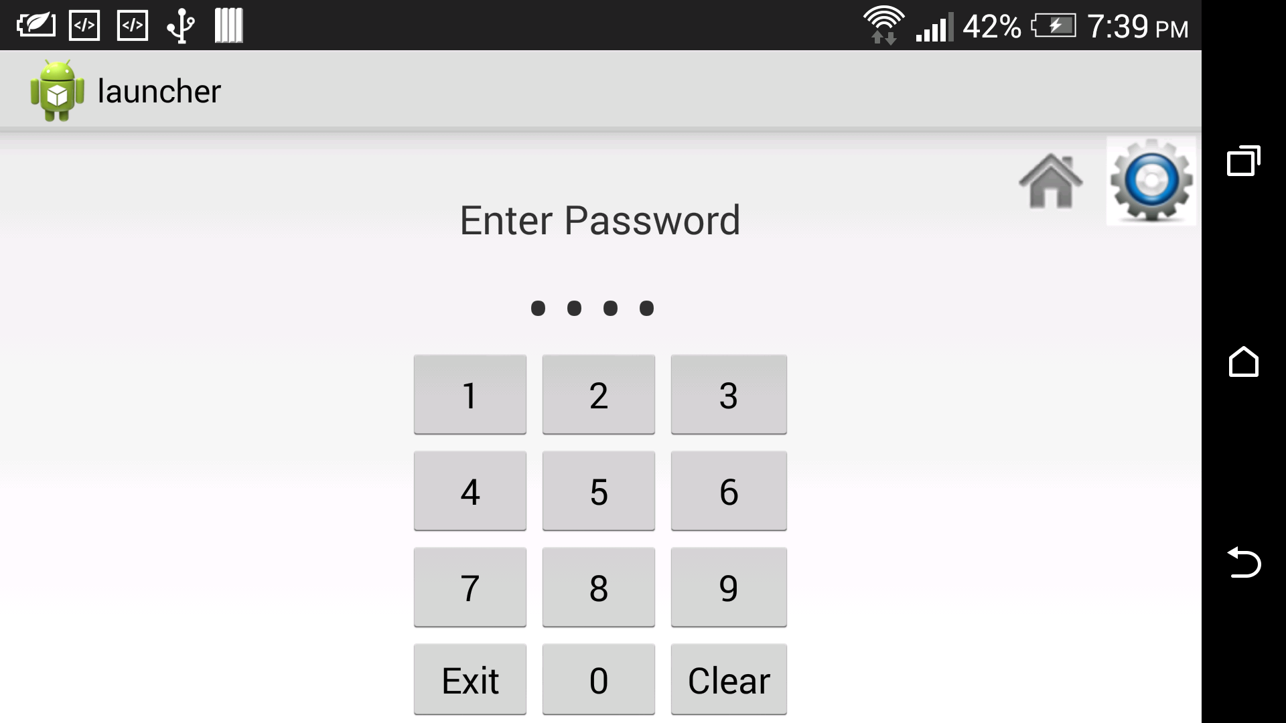
Password protected Protected mode

Slide 33
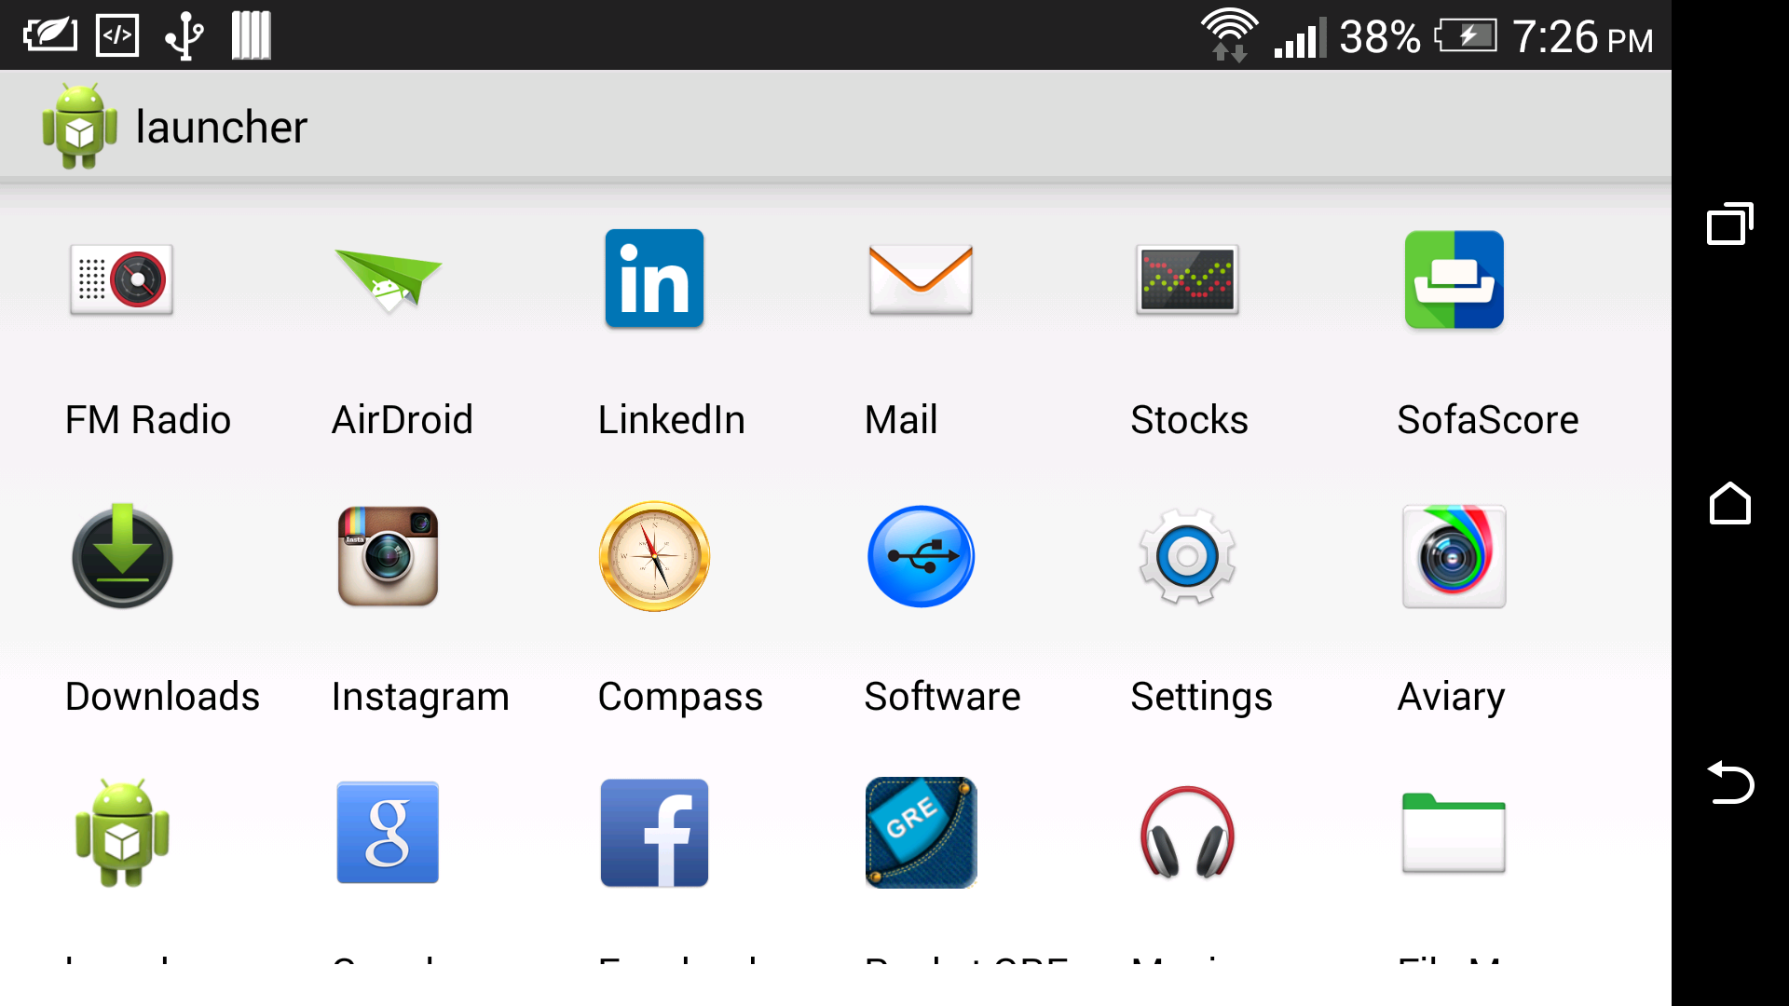
Inbuilt Application

Slide 34
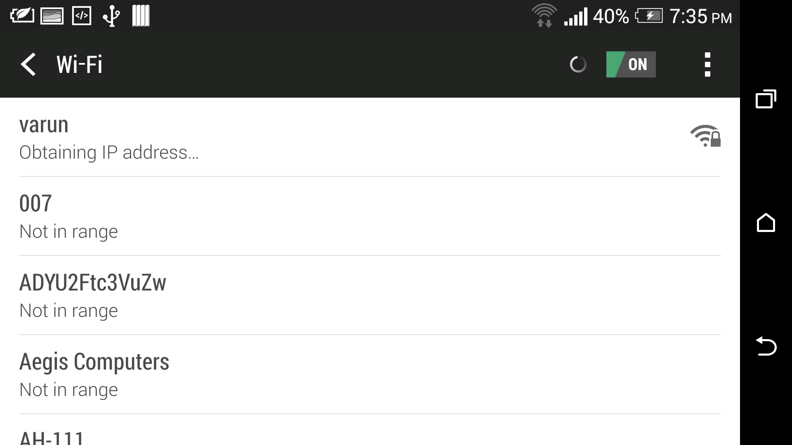
Wi-fi settings to connect to master device

Slide 35
Future Scope And Enhancement
Present system carries certain drawbacks and limitations as listed below:
In current application, Teachers will connect the users. The whole administration is with Teachers only.
The performance of other students can't be seen by User. The performance of all the students can only be seen only by Teachers.
Teachers can connect to the students by, only his/her own tablets.
The tablets must be booted for security purpose..
The students themselves can't be connected to each other, for a group activity. They can be only connected to teachers, only. But, it can be implemented, by many-to-many networking policy.

Slide 36
Thank You

